Slide 1
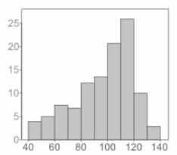
SQuAD Question Answering
Imbalance
Gagan Gopinath, Sai Raghava Mukund, Tarun Anand

Slide 2

Introduction
What is Question Answering?
Types of Question Answering
What is SQuAD?

Slide 3
Motivation
Assignment - 3 Analysis

Slide 4
Contribution

Slide 5
Related Work

Slide 6
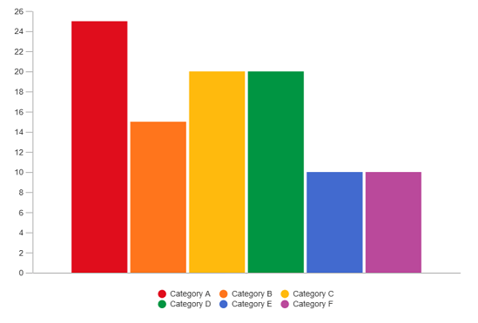
Approach
Undersampling
Question generation
CoQA Dataset

Slide 7
Approach
Passage
Undersampling
Question generation
CoQA Dataset
Q/A Generator
Question
Answer
Filter
Under-represented Question-Answer Pairs

Slide 8
Approach
Undersampling
Question generation
CoQA Dataset
CoQA Dataset
SQuAD Dataset

Slide 9
Results
Graphs and accuracies

